Slide 1
Object detection, Tracking and Speed Estimation
By
Amirthavarshini V

Slide 2
Contents
Introduction
Terminology
Objectives
Results and discussion
Conclusion
References
Future Scope
Flow chart of methodology

Slide 3

Introduction
In the realm of urban surveillance and traffic management, the integration of object detection, tracking, and speed estimation using CCTV videos plays a pivotal role in shaping safer and more efficient cities.
By employing advanced computer vision technologies, this approach enables real-time identification of vehicles, pedestrians, and objects, contributing to traffic flow analysis and optimization.
The continuous monitoring and tracking of objects provide valuable insights for public safety, security, urban planning, and infrastructure optimization.
Speed estimation further enhances the system's capabilities by providing critical data for traffic management, law enforcement, and event planning.
This cohesive utilization of technologies not only fosters safer streets and efficient traffic control but also lays the foundation for data-driven decision-making in urban environments.

Slide 4
Terminology
YOLO (You Only Look Once) is a groundbreaking object detection algorithm known for its speed and accuracy. Unlike traditional methods, YOLO divides an image into a grid and predicts bounding boxes and class probabilities simultaneously. This one-pass approach allows YOLO to achieve real-time object detection, making it widely adopted in applications such as autonomous vehicles, surveillance, and image analysis. YOLO has multiple versions, with YOLOv4 and YOLOv5 being notable iterations, continually pushing the boundaries of object detection performance. Its efficiency and versatility have established YOLO as a go-to solution in the computer vision community.
DeepSORT (Deep Simple Online and Realtime Tracking) implemented in PyTorch is an extension of the SORT (Simple Online and Realtime Tracking) algorithm with deep learning capabilities. It combines object detection and deep feature embeddings to achieve robust and accurate multi-object tracking. DeepSORT excels in scenarios with crowded and complex scenes, maintaining identities across video frames. Its PyTorch implementation allows for seamless integration into deep learning pipelines, making it a popular choice for tracking individuals or objects in real-time video streams.
Speed Distance formula : To find speed using the distance formula, divide the distance traveled (d) by the time taken (t): Speed=td​. The result is the rate at which an object covers a certain distance in a given time interval.

Slide 5
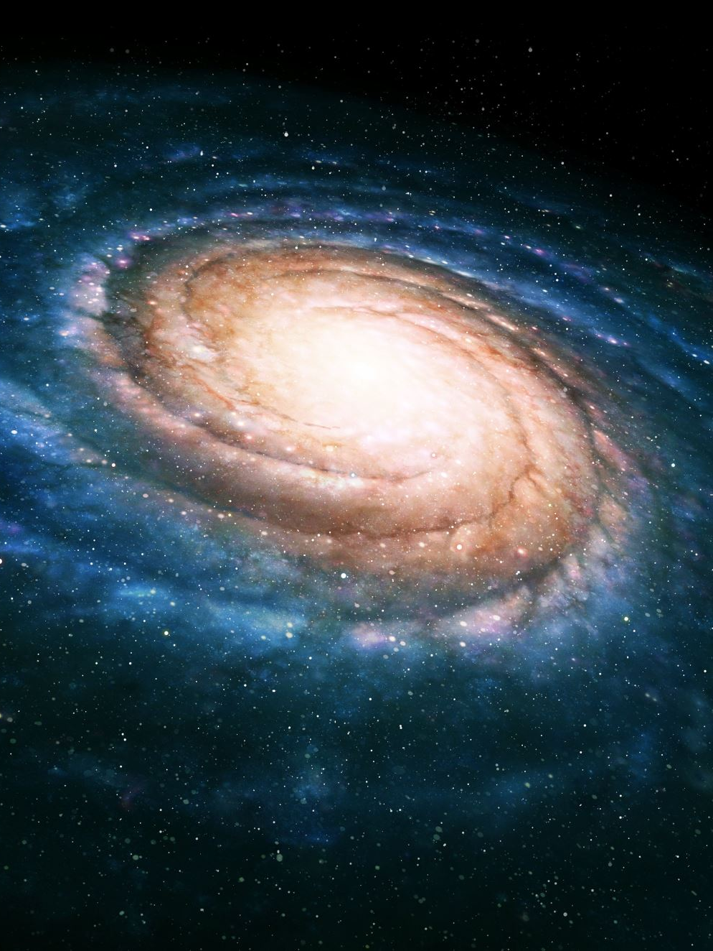
Objectives
The objectives of the Task of Phase III are
Objection Detection: We train the images with their annotations using Yolo and extract the weights as yolo8.pt
Object Tracking: The deepsort is an improved version of the SORT (Simple Online and Realtime Tracking) algorithm with deep learning capabilities. It combines object detection and deep feature embeddings to achieve robust and accurate multi-object tracking.
Speed Detection: The speed is detected using the trail of the object_id between each frame. It is achieved using the Pythagoras theorem and speed distance formula

Slide 6
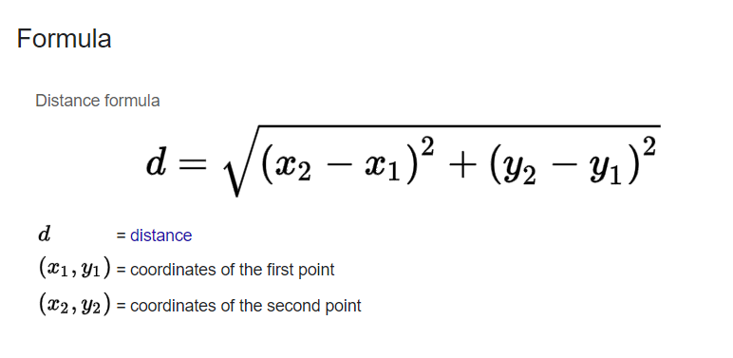
Methodology
Preprocess the dataset using custom function to convert into txt from xml
Write a yaml file for YOLO and train the dataset.
Write functions to find the trail of each object_id between the frames
Integrate Deep sort pytorch with YOLO weights
speed = distance ÷ time
Using two formula we estimate the speed.
Write a function to get the results

Slide 7
Tools and Dataset
Python: A popular programming language for data science and machine learning tasks.
PyTorch: A deep learning framework known for its dynamic computation graphs and widely used in research and development.
NumPy: A Python library for numerical computations, essential for handling arrays and matrices in image processing.
Pandas: A powerful library for data manipulation and analysis, useful for preprocessing datasets.
Matplotlib: A library for creating visualizations, helpful for analyzing model performance and results.
scikit-learn: A machine learning library often used for data splitting, evaluation metrics, and hyperparameter tuning.
Jupyter Notebook: An interactive computing environment for developing and presenting code collaboratively.
Star-Galaxy Classification Dataset: The dataset used in the stud for training and evaluating the CNN models.

Slide 8
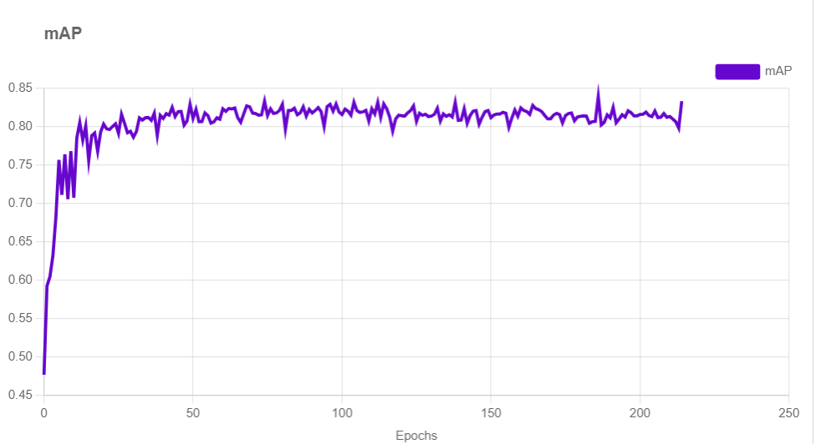
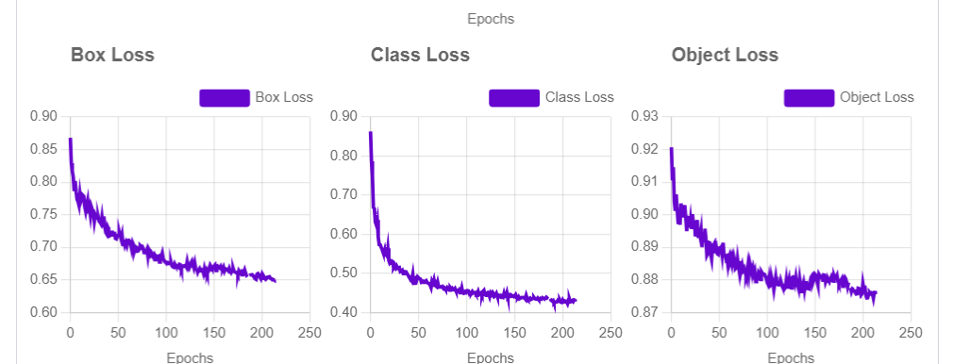
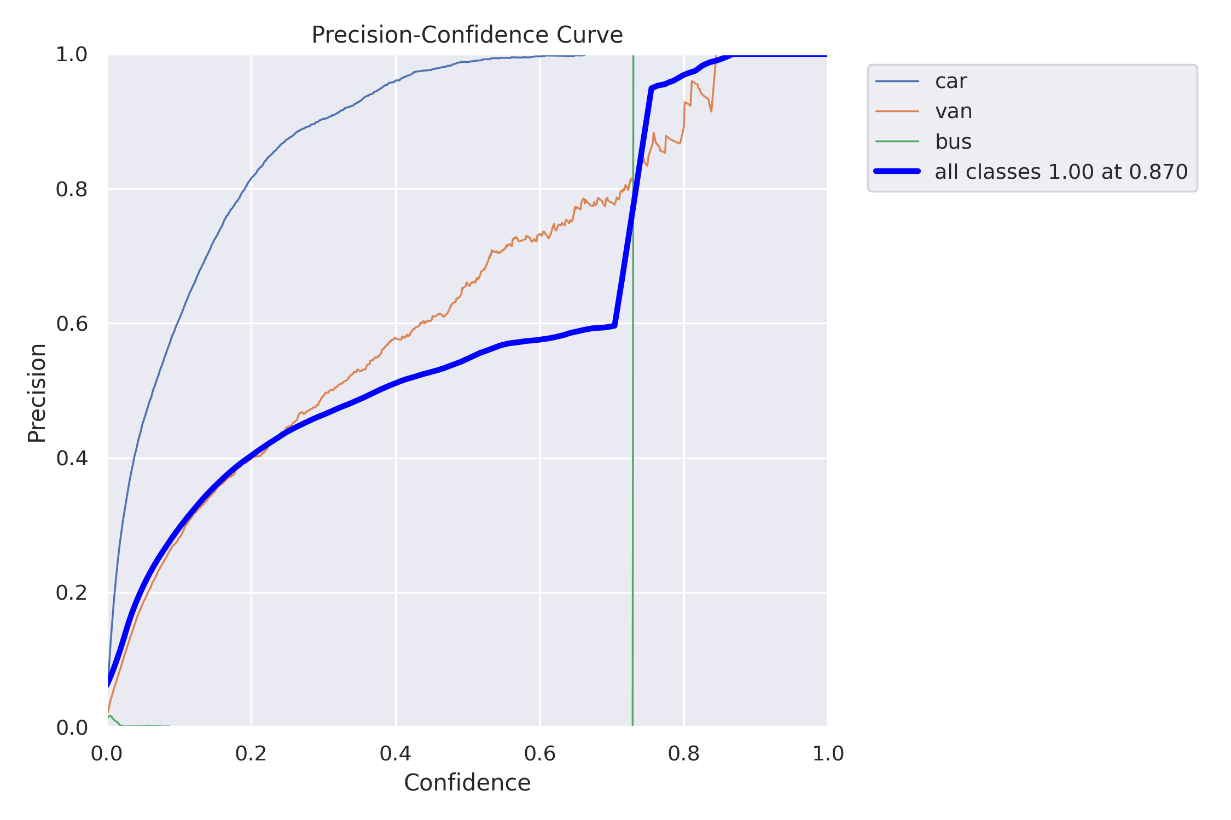
Results

Slide 9
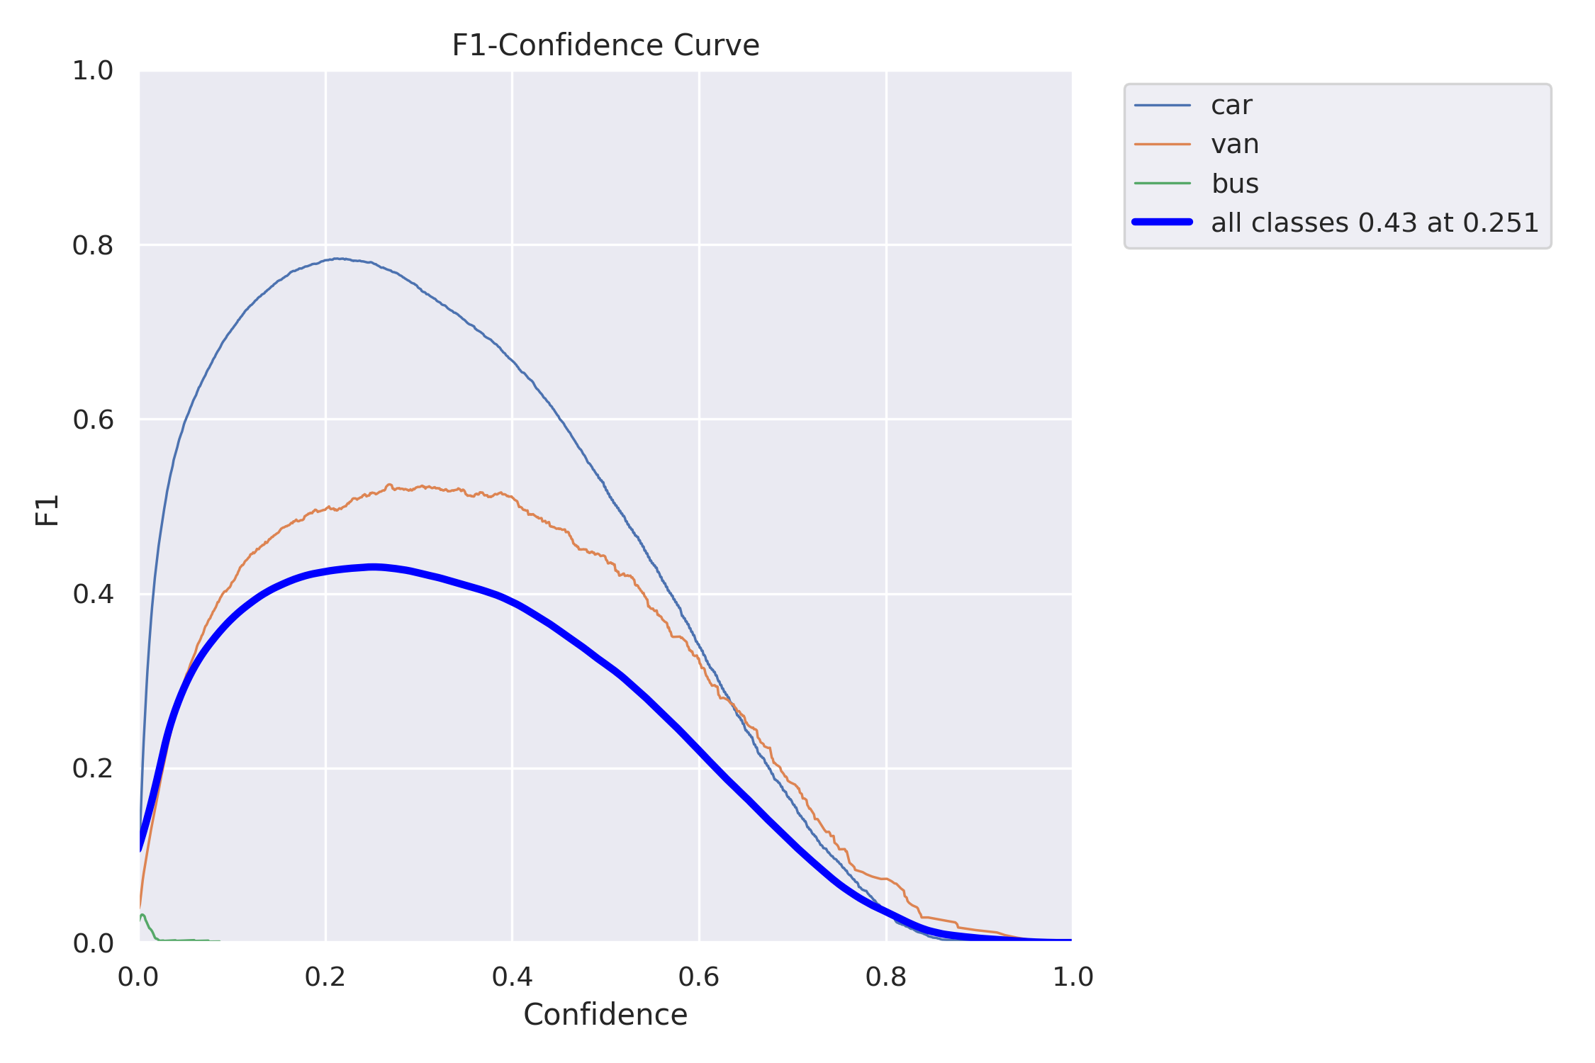
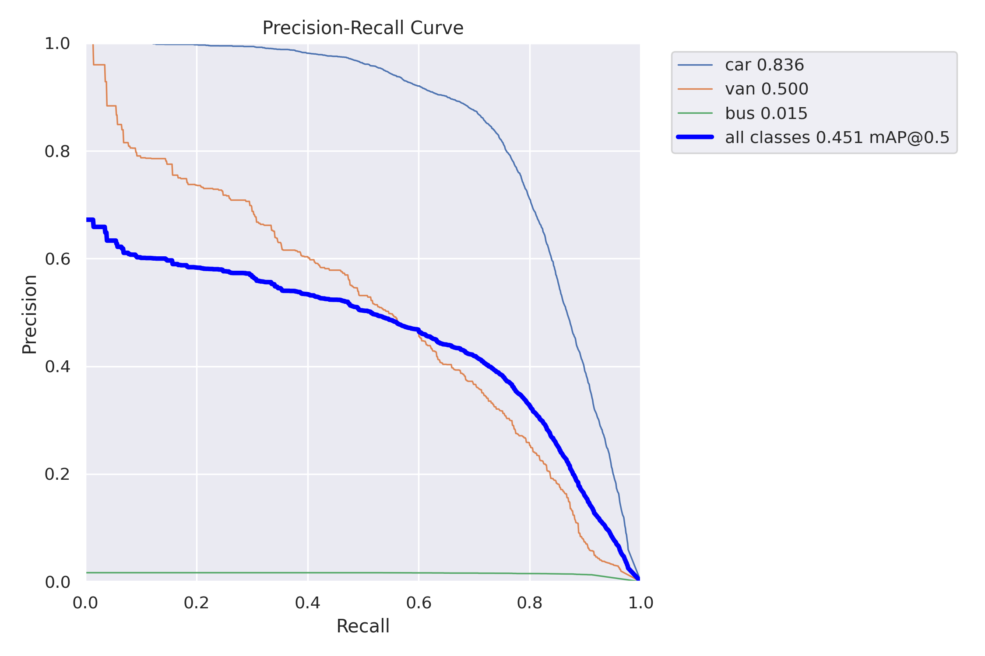
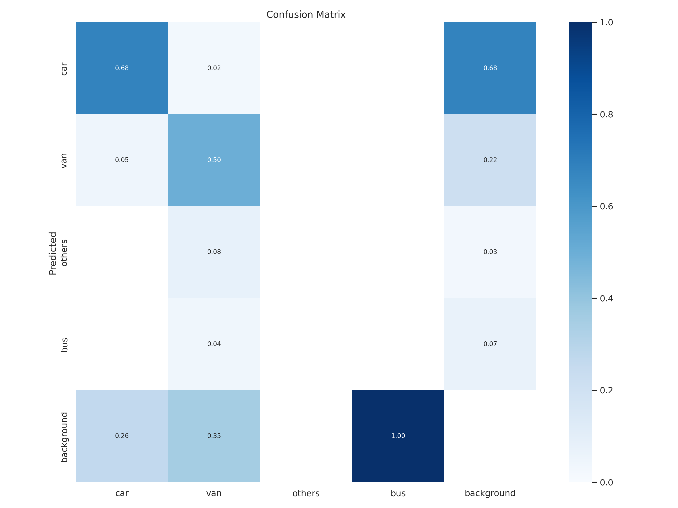
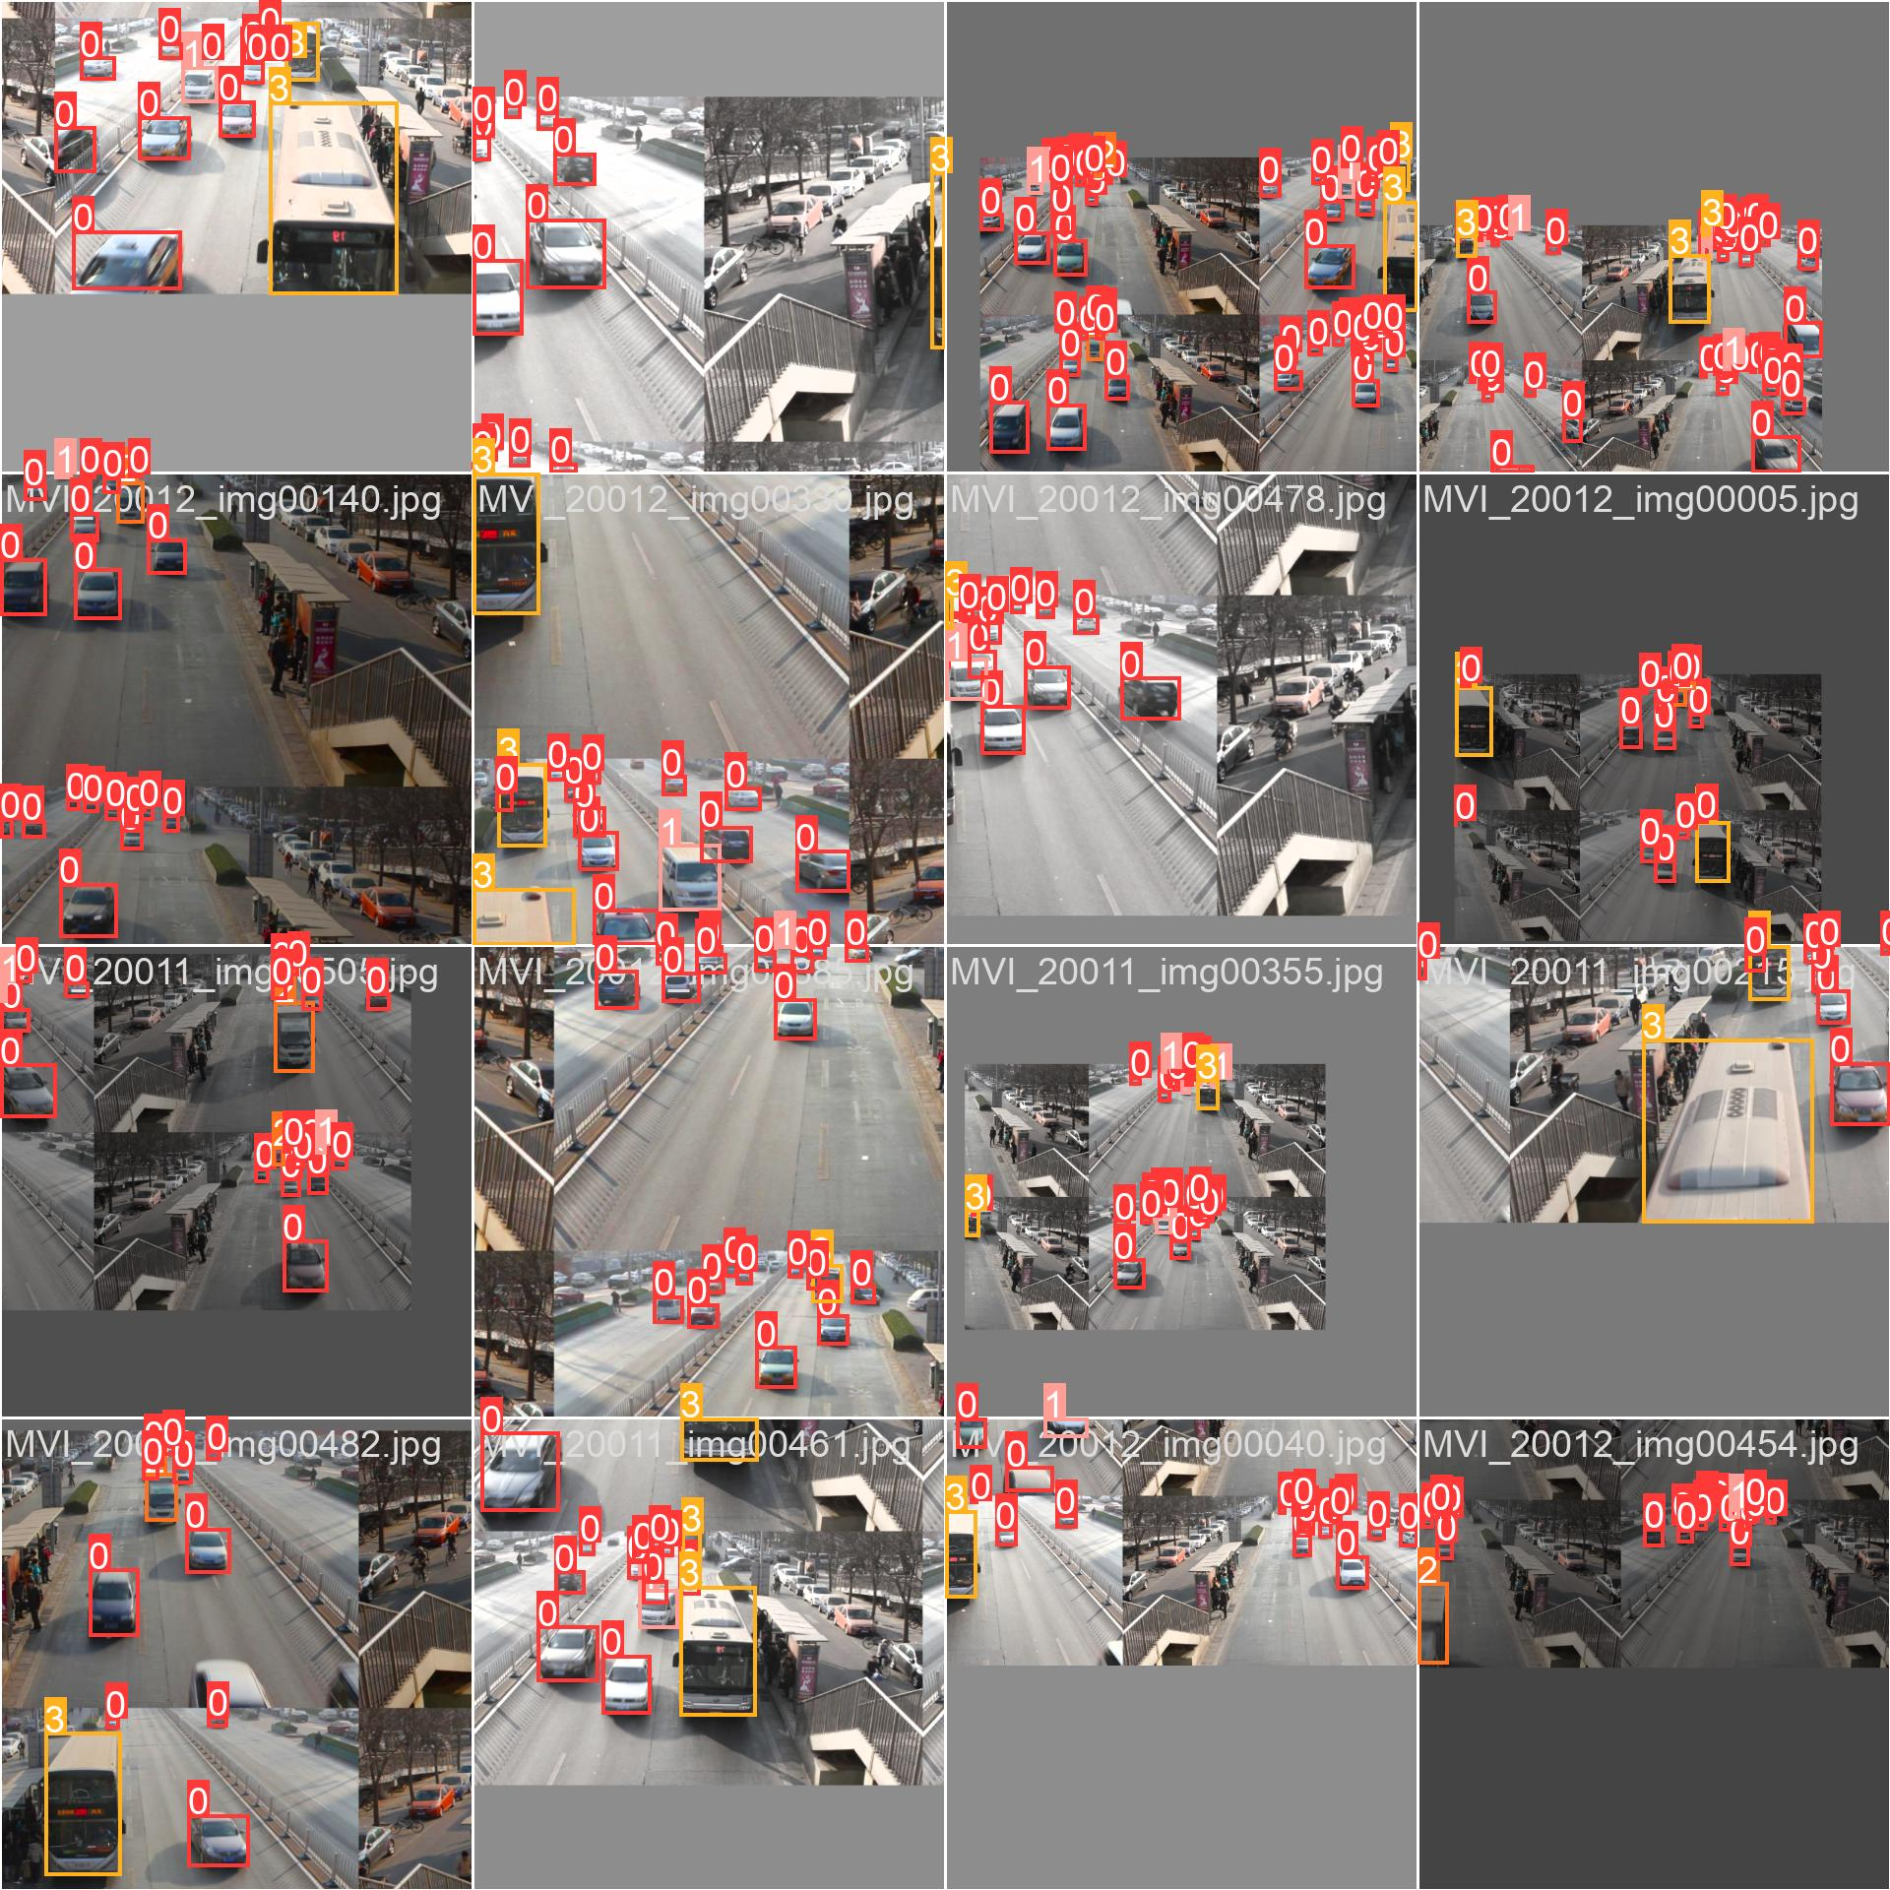
Results

Slide 10
Conclusion
Thus we utilizes YOLO for object detection and DeepSORT for tracking, estimating the speed of detected objects. It logs predictions, including frame number, bounding box, object ID, and speed, into a CSV file.
The system visualizes tracking results with bounding boxes, trails, and directional lines.
It offers a modular and structured solution for real-time object tracking and speed detection in video streams.
Customization for specific applications and real-world calibration for accurate speed measurements may be required.

Slide 11
Future Scope
Future research should explore alternative CNN architectures and hyperparameter configurations to unlock even higher performance levels. And exploring ensemble learning, transfer learning, and data augmentation.
The implications of this study extend beyond astronomy, finding applications in precise image classification in medical imaging, autonomous vehicles, and robotics.

Slide 12
References
Jing-Hang Shi, Bo Qiu, A-Li Luo, Zhen-Dong He, Xiao Kong, Xia Jiang, Stellar classification with convolutional neural networks and photometric images: a new catalogue of 50 million SDSS stars without spectra, Monthly Notices of the Royal Astronomical Society, Volume 520, Issue 2, April 2023, Pages 2269–2280, https://doi.org/10.1093/mnras/stad255
Bhuvaneshwari, R., Karthika Devi, M.S., Vishal, R., Sarvesh,E.,Sanjeevaditya,T.M.(2023). CoSSC—Comparative Study of Stellar Classification Using DR-16 and DR-17 Datasets. In: Kumar, S., Sharma, H., Balachandran, K., Kim, J.H., Bansal, J.C. (eds) Third Congress on Intelligent Systems. CIS 2022. Lecture Notes in Networks and Systems, vol 608. Springer,Singapore.https://doi.org/10.1007/978-981-19-9225-4_45
Xiaohua Ma, Xiangru Li, Ali Luo, Jinqu Zhang, Hui Li, Galaxy image classification using hierarchical data learning with weighted sampling and label smoothing, Monthly Notices of the Royal Astronomical Society, Volume 519, Issue 3, March 2023, Pages 4765–4779, https://doi.org/10.1093/mnras/stac3770
Yufan Chen, "Celestial image classification based on deep learning and FGSM attack," Proc. SPIE 12509, Third International Conference on Intelligent Computing and Human-Computer Interaction (ICHCI 2022), 125092R (12 January 2023); https://doi.org/10.1117/12.2656011
Jimenez, M., Alfaro, E. J., Torres, M. T., & Triguero, I. (2023). CzSL: Learning from citizen science, experts and unlabelled data in astronomical image classification. ArXiv [Astro-Ph.GA]. Retrieved from http://arxiv.org/abs/2302.00366
Deepa, S., Gokila, S. (2023). Comparative Analysis of Different Machine Learning Prediction Models for Seasonal Rainfall and Crop Production in Cultivation. Computational Methods and Data Engineering. Lecture Notes on Data Engineering and Communications Technologies, vol 139. Springer

Slide 13
Reference (contd)
Feihu Wang, Tao Hu, Minjuan Gu, "Detection and classification of galaxy morphology based on YOLOv5," Proc. SPIE 12511, Third International Conference on Computer Vision and Data Mining (ICCVDM 2022), 125111C (3 February 2023); https://doi.org/10.1117/12.2659975
Ghadekar, P., Chanda, K., Manmode, S., Rawate, S., Chaudhary, S., Suryawanshi, R. (2022). Galaxy Classification Using Deep Learning. In: Rajagopal, S., Faruki, P., Popat, K. (eds) Advancements in Smart Computing and Information Security. ASCIS 2022. Communications in Computer and Information Science, vol 1759. Springer, Cham. https://doi.org/10.1007/978-3-031-23092-9_
Ghadekar, P., Chanda, K., Manmode, S., Rawate, S., Chaudhary, S., Suryawanshi, R. (2022). Galaxy Classification Using Deep Learning. In: Rajagopal, S., Faruki, P., Popat, K. (eds) Advancements in Smart Computing and Information Security. ASCIS 2022. Communications in Computer and Information Science, vol 1759. Springer, Cham. https://doi.org/10.1007/978-3-031-23092-9_
T. Mehta, N. Bhuta and S. Shinde, "Experimental Analysis of Stellar Classification by using Different Machine Learning Algorithms," 2022 International Conference on Industry 4.0 Technology (I4Tech), Pune, India, 2022, pp. 1-8, doi: 10.1109/I4Tech55392.2022.9952964.
Qi, Zhuliang. (2022). Stellar Classification by Machine Learning. SHS Web Conf., 144, 03006. doi:10.1051/shsconf/202214403006
Bai, Y., Liu, J., Wang, S., & Yang, F. (2018). Machine Learning Applied to Star–Galaxy–QSO Classification and Stellar Effective Temperature Regression. The Astronomical Journal, 157(1), 9. doi:10.3847/1538-3881/aaf009
Viquar, Mohammed & Basak, Suryoday & Dasgupta, Ariruna & Agrawal, Surbhi & Saha, Snehanshu. (2018). Machine Learning in Astronomy: A Case Study in Quasar-Star Classification.
Ball, N. M., Brunner, R. J., Myers, A. D., & Tcheng, D. (2006). Robust Machine Learning Applied to Astronomical Data Sets. I. Star-Galaxy Classification of the Sloan Digital Sky Survey DR3 Using Decision Trees. The Astrophysical Journal, 650(1), 497. doi:10.1086/507440
Odewahn, S.C., Stockwell, E.B., Pennington, R.L., Humphreys, R.M., Zumach, W.A. (1992). Automated Star/Galaxy Discrimination with Neural Networks. In: MacGillivray, H.T., Thomson, E.B. (eds) Digitised Optical Sky Surveys. Astrophysics and Space Science Library, vol 174. Springer, Dordrecht. https://doi.org/10.1007/978-94-011-2472-0_28

